Slide 1
FAULT DETECTION IN DISTRIBUTION LINE AND PROTECTION OF DEVICES
Project Members:
Pujan Thapa Magar (32027)
Abhijeet Chaudhary (32033)
Aship Chaudhary (32034)
Yubraj Chimoriya (32039)
Supervisor:
Brijesh Adhikary
Associate Professor
Department of Electrical & Electronics Engineering

Slide 2
Outline of Presentation
Introduction
Problem definition
Objectives of the Project
Limitation
Literature Review
Project Methodology
Project Description
Results and Discussions
Conclusions and Future works
References

Slide 3
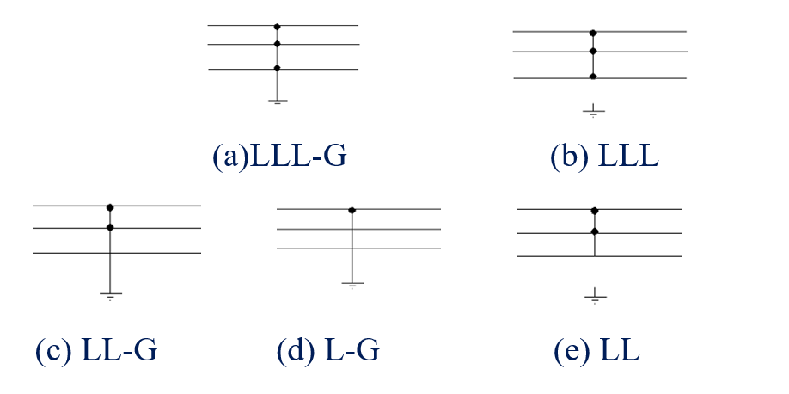
Introduction
Any undesirable and unavoidable incidents that can disturb the stable condition of the power system.
Causes of faults: lightening, trees, birds, fog, ice, broken insulators, etc.
Types of fault:

Slide 4
Problem Definition
Manual detection of fault and its location.
Time consuming because of survey.
Effects various home appliances along with instruments in generation and distribution unit.

Slide 5
Objectives of the Project
To detect and classify type of fault in 3-phase line.
To find the approximate location and distance of fault from substation.
To communicate the control room about the faulty area.

Slide 6
Limitation
Loads are not used in this project since distribution line is of 12 volt line to neutral.
The prototype can only classify LG, LL-G, LLL-G fault.

Slide 7
Literature Review
Distribution line and its classification: Primary distribution line and secondary distribution line.
Configuration of distribution system.
Choice of conductor and the factors on which the conductor size depends on.
Introduction, causes and types of fault.
Mathematical algorithm to classify type of faults.

Slide 8
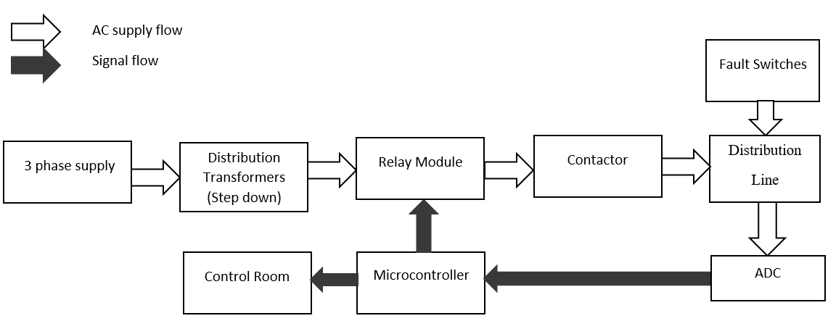
Block diagram

Slide 9
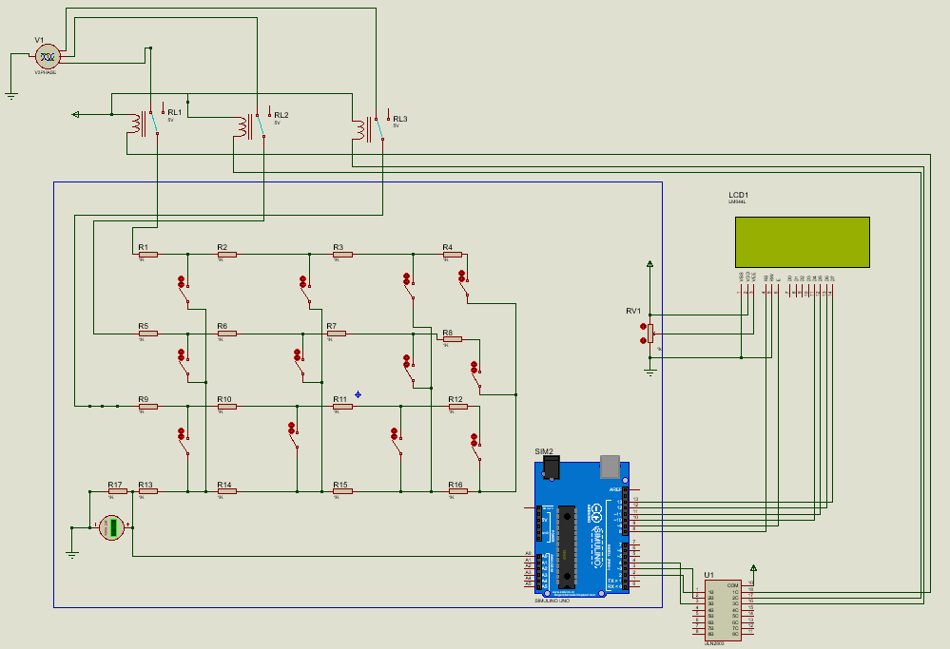
Circuit Diagram

Slide 10
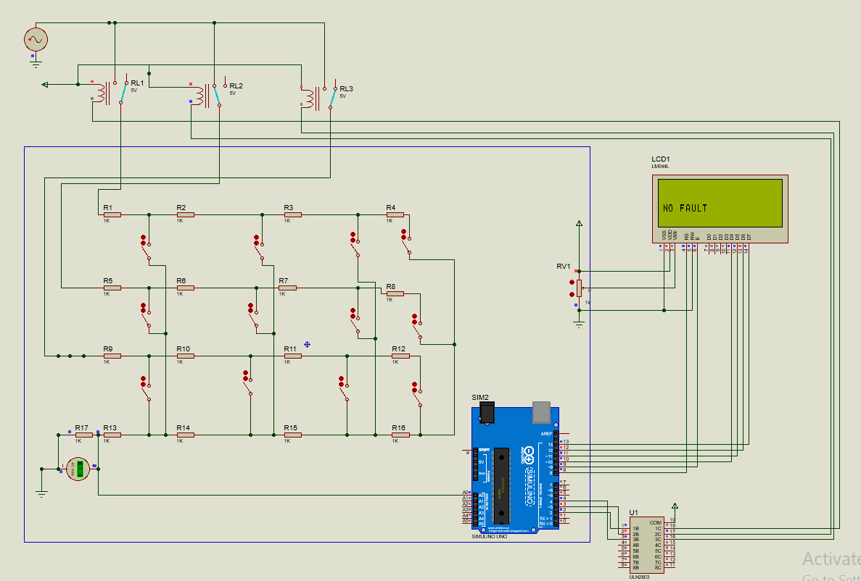
Simulation: When there is no fault

Slide 11
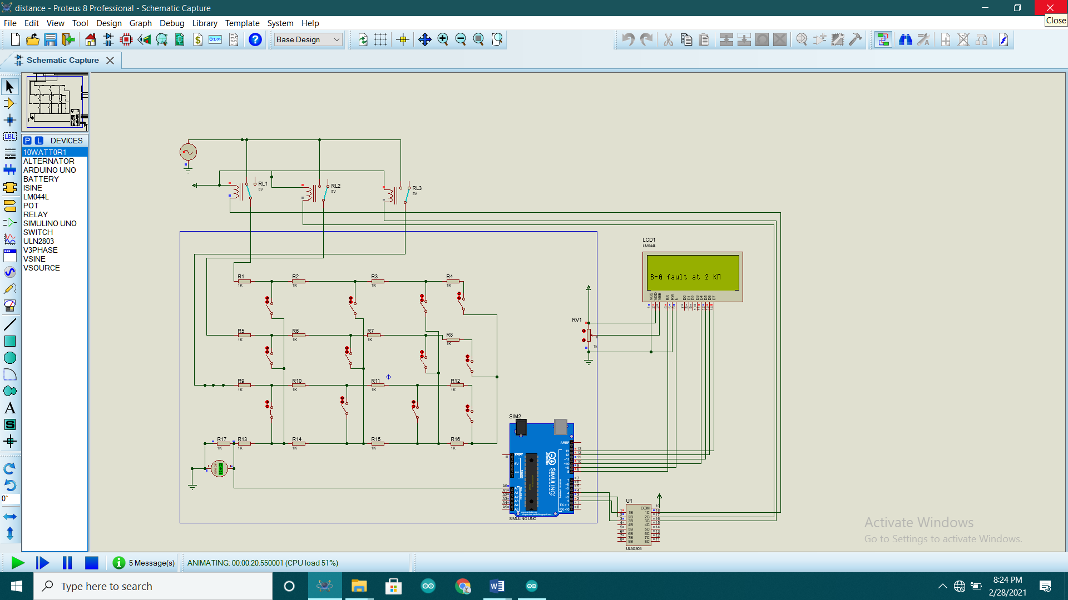
Simulation: When there is single line to ground fault at 2 km

Slide 12
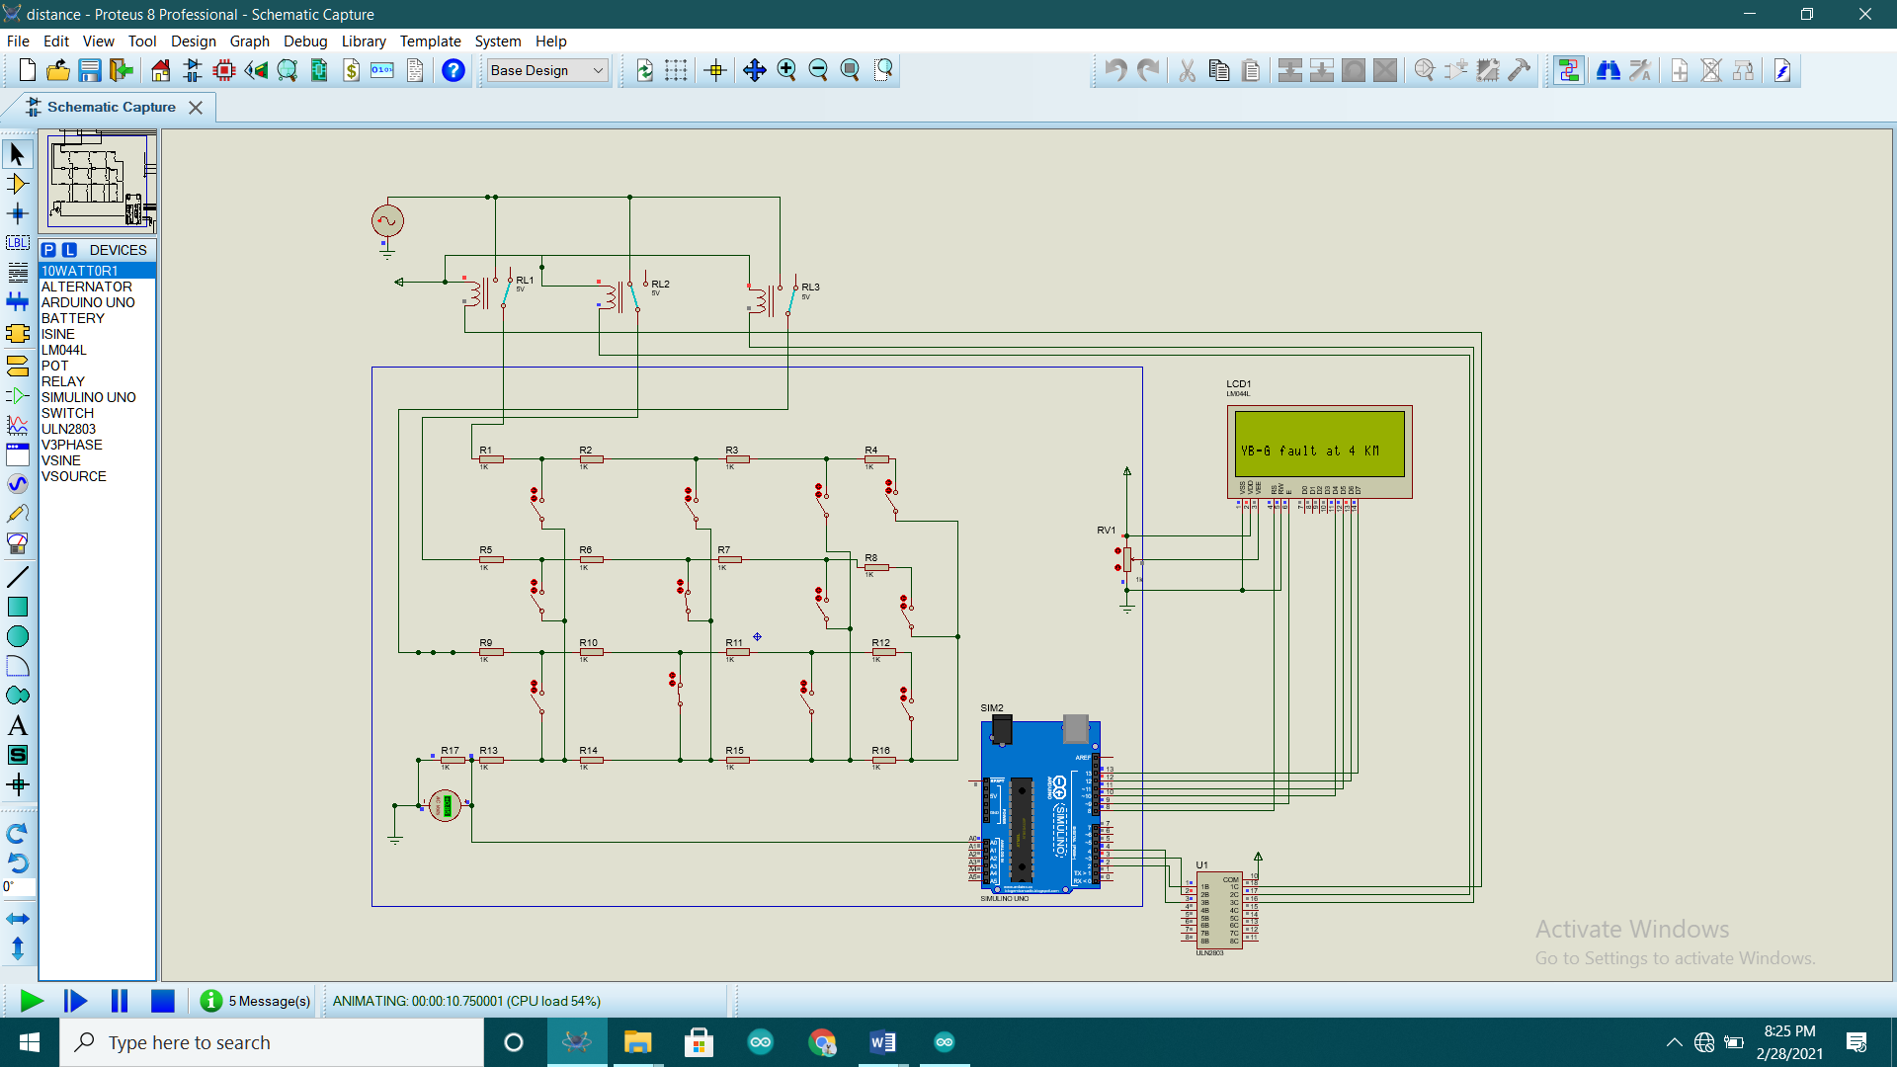
Simulation: When there is double line to ground fault at 4 km

Slide 13

Simulation: When there is triple line to ground fault at 8 km

Slide 14
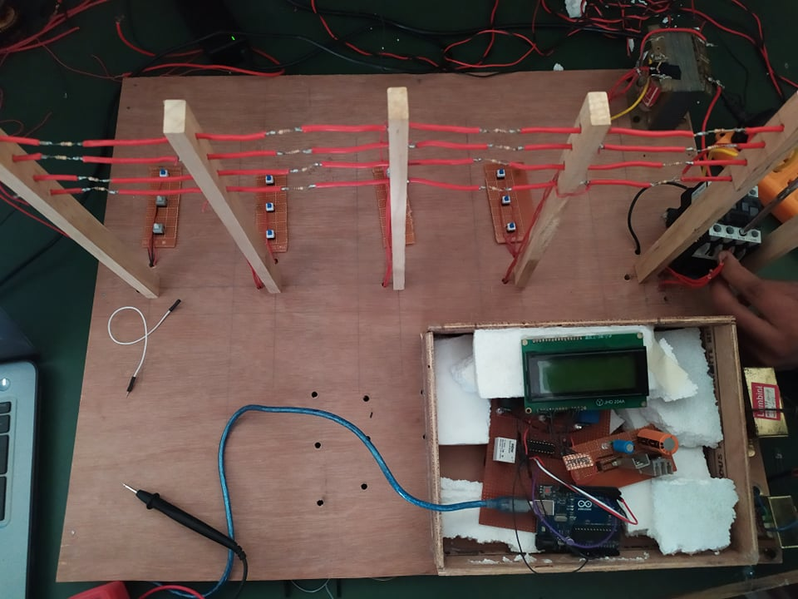
Hardware Implementation

Slide 15
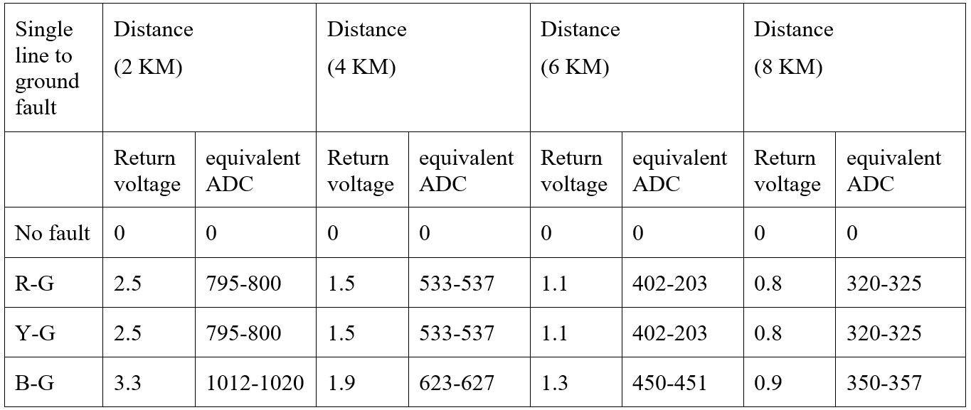
Results and Discussions
Voltage and equivalent ADC for single line to ground fault.

Slide 16
Conclusion
The primary of three transformer can be given to single phase AC supply using extension board or three lines of primary can be given to three phase supply. The voltage it can work with is 217 volt to 227 volt Line to Neutral. It doesn't work if the voltage is outside this range.
It take about 1 second to check the fault at all 3 phases.
There is a contactor in the project which cut off the voltage when fault occurs. And after the fault is detected fault clearing time given is 10 second at which the fault has to be cleared.

Slide 17
Future work
Some improvements that can be done on the project are:
Using different arduino in different phases thereby decreasing time delay.
Improving algorithm to detect LL and LLL faults.

Slide 18
References
Dalstein, Thomas and Kulicke, Bernd (April 1995). Neural Network Approach to Fault Classification for High speed Protective Relaying. IEEE Transactions on Power Delivery, 10 (2), 1002-1009.
Deshpande, M.V. (1984) Electric Power Systems. 62-75. Tata McGrew-Hill Publishing Company Limited.
Eaton, J. Robert, and Cohen, Edwin (1983).Electric Power Transmission Systems, (2nd Ed.). Prentice-Hall Inc.
MacDonald (1969). Power System Protection, 1, The Electricity Council.
Fonseca, J.R., Tan, A.L., Monassi, V., Janquira, W.S., Silva, R.P., Assuncano, L.A.R., and Melo, M.O.C. (April 1990) Effects of Agricultural Fires on the Performance of Overhead Transmission Lines. IEEE Transactions on Power Delivery, 5(2), 687-694.
Furukawa, Shuji, Usada, Osamu, Isozaki, Tashaki, and Irie, Tashaki (October 1989). Development and Application of Lightning Arresters for Transmission Lines. IEEE Transactions on Power Delivery, 4(4), 2121-2127
Gonen, Turan, (1988). Electric Power Transmission System Engineering: Analysis and Design. John Wiley & Sons.
Gonen, Turan (1987). Modern Power System Analysis. John Wiley and Sons.
Urasawa, K., Kanemaru, K., Toyota, S,. and Sugiyama, K. (October 1989). New Fault Location System For Power Transmission Lines Using Composite Fiber-Optic Overhead Grounding Wire (OPGW). IEEE Transactions on Power Delivery, 4, 2005-2011.
Simulink Library Reference Manual, The Mathworks.

Slide 19

…thank you …

